Slide 1

Coalitions Lite Meeting 1
Plan for Coalitions Lite

Slide 2
Welcome, Introductions, & Overview
15 minutes

Slide 3
Meeting Logistics and Overview
Team “check-in” and introductions
Identify a notetaker and timekeeper
Decide on a shared document platform
Determine how to get feedback from stakeholders
Notes:
SAY:
Our check-in question today is: [Facilitator choses a check-in question before the meeting]
Who can take notes today? We’ll want to be sure we’re capturing key discussion points, decisions made, assignments, and action steps in the meeting notes.
Who can make sure we stay on time? The timekeeper should be comfortable keeping the group on schedule.
How can we share our files? Would Dropbox or Google Docs work? Is there somebody who could set up a shared folder for us?
Throughout Coalitions Lite, we will be voting and making joint decisions. We will use different voting techniques throughout.
Finally, are there are other coalition members, key leaders, or stakeholders who may need to approve our Coalitions Lite work? How often will we check-in with them during the process? Do we need formal approval from them or just input and feedback?
~
NOTE TO FACILITATOR
Voting methods can be found in the Voting Techniques information sheet.

Slide 4
Meeting Objectives
Assess the coalition’s capacity to engage in Coalitions Lite strategic planning process
Review Coalitions Lite
Create a plan for conducting the Coalitions Lite process
Outline next steps
Notes:
SAY: Most Coalitions Lite meetings move fast! If we need more time, we can always split the meetings into two.

Slide 5
Assess Coalition Capacity
10 minutes

Slide 6
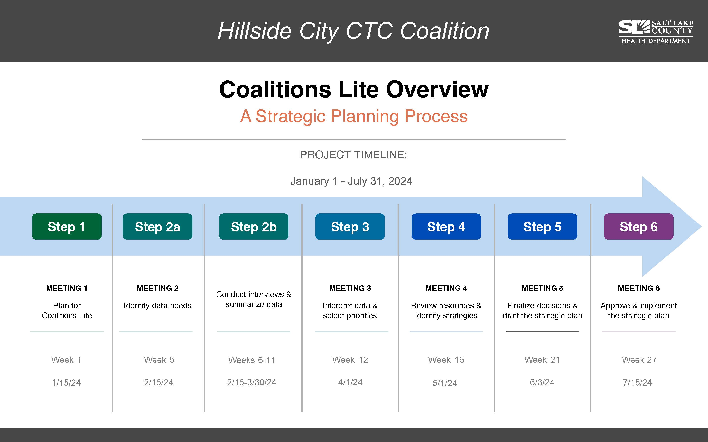
Notes:
Walk the group quickly through the 6 steps.
SAY: We do not need to understand all the details of each step right now. This is an example of a Coalitions Lite timeline. Our timeline may look different! We will figure that out today.

Slide 7
Importance of Strategic Planning for Coalitions
Planning now makes for a more efficient and effective process later.
Helps to identify potential barriers/prevent them.
Helps to ensure our capacity for engaging in the process.
Contributes to continuity and sustainability.
Increase the coalition’s impact in the community by focusing resources on high priority needs.
Have a better understanding of the challenges your community is facing and how to best address those challenges.
Provide clear direction for your activities as membership changes and grows, increasing the sustainability of the coalition and your efforts.
Notes:
SAY: Why do you think going through a strategic planning process together is important?
~
NOTE TO FACILITATOR
Once they have given some reasons, CLICK for additional reasons.

Slide 8
Coalition Capacity for Strategic Planning
Is this process important to our coalition’s effectiveness? Why or why not?
Do we have enough active members to carry this work? If not, what do we need to do to increase our capacity?
Does everyone have a general understanding of this process?
Notes:
SAY: It’s important for the coalition to support the Coalitions Lite process. There is a lot of work involved and, to draft a strong strategic plan, we must all be bought in to the process.
~
NOTE TO FACILITATOR
Ask the questions on the slide and facilitate a brief discussion for each. Have the notetaker capture any concerns or assignments.

Slide 9

Check-In: Thumb Vote!
Does everyone support our coalition doing this work?
Yes! Maybe, can we Nope!
discuss?
Notes:
SAY: Let’s check-in with the whole group and make sure we’re on the right track.
(see the Voting Techniques information sheet)
~
NOTE TO FACILITATOR
If some people are not supportive, have them explain their reasonings behind their preferences until you can come to an agreement that everyone can get behind.

Slide 10
Increasing Support and Buy-In (if needed)
Meet individually with key leaders and coalition members to explain the process and why it’s important. Ask them whether they can support the effort.
Ask someone from the Health Department or another coalition that has conducted strategic planning to present at an upcoming coalition meeting.
Other strategies to increase coalition buy-in?
Notes:
NOTE TO FACILITATOR
SKIP this slide if everyone is already bought into the Coalitions Lite process.
If some folks still need convincing, discuss the options on the slide and make a plan to do these activities.

Slide 11
Create A Plan for Conducting Coalitions Lite
45 minutes

Slide 12
Planning for the Coalitions Lite Process
Goal: Agreement on why, when, and how the coalition will conduct Coalitions Lite
To discuss:
  Timeline for the Coalitions Lite process
  Meetings
  Monitoring and sharing progress
Notes:
SAY: This plan will outline how the coalition will go through the Coalitions Lite process to create a strategic plan. We will leave the meeting today with a plan for the process (not the strategic plan itself!). The plan we outline today is not written in stone – we can change it and update it, as needed.

Slide 13
Some Points to Consider for Our Timeline
This process should take 4-8 months (8 months may be more realistic)
Stretching the process out beyond 8 months can result in lost momentum, workgroup turnover, and needing to restart the process.
Balance momentum with sticking to the process as it’s laid out; don’t skip steps
Build in time for expected (e.g. holidays) and unexpected delays
Some steps could go on indefinitely (such as data collection) – Decide on a “good enough” stopping point
  Timing for step 2b Interviews / Data gathering is the hardest to predict because we may run into stumbling blocks; Step 2b is a good place to build in “extra” time
We can always adjust the timeline as we move through the process!
Notes:
SAY: We’ll now discuss how long we want the Coalitions Lite process to take overall. Consider these points as we establish our timeline.

Slide 14
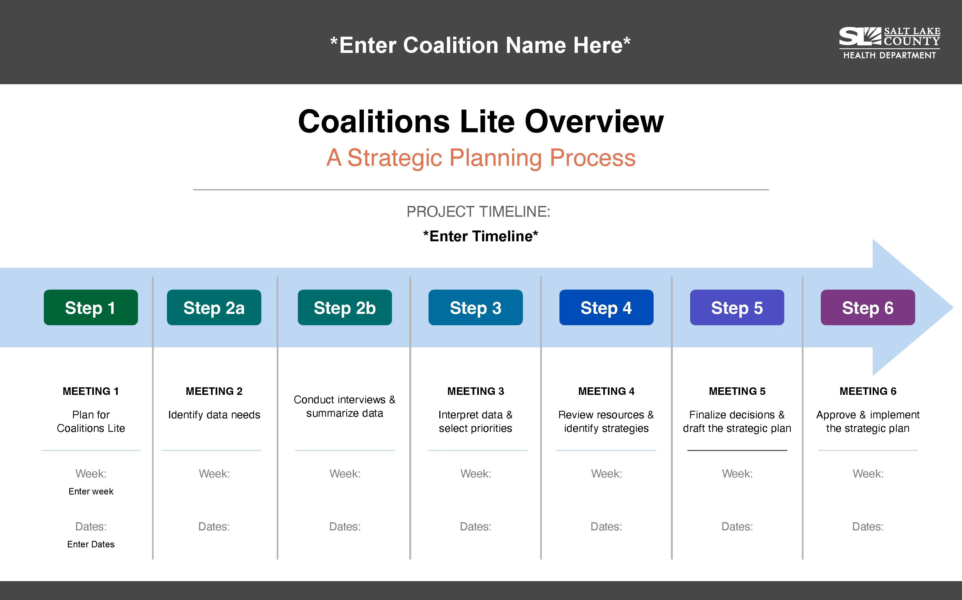
Adjust the Coalitions Lite Timeline
Notes:
SAY: When do we want to accomplish each of these steps? Let’s try to schedule estimated (or exact!) dates for each meeting. This is Meeting #1, so today is our start date.
~
NOTE TO FACILITATOR
Have the notetaker capture the decisions directly in the Coalitions Lite Plan template. The notetaker can also fill in the editable Coalitions Lite Overview pdf.

Slide 15
Approvals and Sharing Progress
What approvals do we need?
  Priority issues
  Strategies
  Final Strategic Plan
  What else?
How will we update other coalition members or stakeholders on our progress?
  This is important for continuity, accountability, and buy-in.
  When, where, how, and who is responsible for updates?
  Consider adding a standing agenda item for updates to larger coalition meetings or sending out monthly progress emails
Notes:
NOTE TO FACILITATOR
Have the notetaker enter the group’s decisions directly into the Coalitions Lite Process Plan template.

Slide 16
Monitoring & Celebrating Progress
Do we need to assign someone to remind participants of their assignments and timelines?
How will lack of follow-through be handled?
How will we acknowledge and celebrate our progress?
  Celebrate individual and whole group contributions
  Build celebrations into timeline when certain milestones are reached
  Examples: gift cards, acknowledgement at larger coalition meetings, reports back to members’ agencies, a virtual or handwritten card, a final celebration, providing food or a special treat during a meeting, coalition swag, etc.
Notes:
NOTE TO FACILITATOR
Have the notetaker enter the group’s decisions directly into the Coalitions Lite Process Plan template.

Slide 17
Meetings
Will meetings be conducted in person, virtual, or both?
  For in person, where will meetings be held? What technology will we need?
  For virtual, what platform will be used? Are all members proficient with and have access to the platform?
What happens when someone can’t attend a meeting?
Under what circumstances should a meeting be canceled or rescheduled?
Notes:
NOTE TO FACILITATOR
Have the notetaker enter the group’s decisions directly into the Coalitions Lite Process Plan template.

Slide 18
Roles
Who will plan and facilitate the meetings?
Will we have the same people as notetakers and timekeepers every meeting or share those responsibilities? Who?
Who will follow up with members after the meetings and ensure assignments and activities are on track?
Who will keep an eye on timelines and other project management tasks?
Notes:
NOTE TO FACILITATOR
Project management often falls on the facilitator and/or committee chair. It often makes sense for the facilitator to do all the meeting planning, facilitation, and project management.

Slide 19
What are our Expectations for Coalition Members?
For attendance at meetings
For responses to communications (i.e., emails)
For completion of tasks
For advanced notice when unable to meet or participate
Notes:
NOTE TO FACILITATOR
Have the notetaker enter the group’s decisions directly into the Coalitions Lite Process Plan template.

Slide 20
Determine Resource Needs
15 minutes

Slide 21
What Resources Do We Need?
Coalitions members with specific skills
  Writing, planning, design, facilitation, project management…
Specific experts
  Local data experts, service providers, report designers…
Funding
Possible resource needs:
Meeting space
Materials and supplies
Incentives for meeting attendance (food, drinks, etc.)
Gift cards or other rewards to recognize members’ work
Hiring someone to facilitate meetings
Data collection incentives (for stakeholder interviews)
Strategic Plan design and printing
Notes:
NOTE TO FACILITATOR
Don’t spend too much time here. Resource needs will pop up throughout the process. For now, just think about some obvious and immediate needs.

Slide 22
What is our plan to secure the immediate resource needs? (Hint: You don’t have to do it all right now!)
Who will contact whom?
By when?
What is our “pitch”?
How will we report back?
Consider in-kind donations! Who do we know? Who can we meet?
Notes:
NOTE TO FACILITATOR
Some of these assignments may be tabled until later if the individuals or resources are not needed until later in the process.

Slide 23
Identify Basic Community Strengths and Challenges
20 minutes

Slide 24
Brainstorm as many community strengths as you can in 5 minutes
For example: caring teachers, high levels of home ownership; high graduation rates; strong sense of community; an active organization that provides helpful family programs; etc.
Notes:
NOTE TO FACILITATOR
Capture your ideas on a flipchart
These strengths present opportunities to expand upon what’s already working and reminds the coalition of all the great things happening in your community (it’s not all about solving problems!).

Slide 25
Brainstorm a short list of issues the coalition may want to prioritize
In 1-2 minutes – Shout out possible, high-level priorities that seem to be big issues in our community
Capture all ideas on a flip chart
Examples: Mental health, Diabetes, Substance use, Pollution, etc.
Notes:
SAY: Consider the coalition’s mission/vision/goals; the original reason why the coalition formed; previous or ongoing activities; issues you’re hearing a lot about in the community, etc.
~
NOTE TO FACILITATOR
Your coalition may already have identified priorities, in which case just list them to remind the group.
Post flip chart pages on the wall and write down ideas.

Slide 26
Narrow the List to 2-4 Possible Priorities
(NO MORE!!)
Take 3-5 minutes – Narrow the list to no more than 4
Don’t overthink it! If an issue feels important, it will be apparent. If multiple people see something as an issue, it’s likely an issue.
Write down your reasons for your final selections in the meeting notes.

Slide 27
Wrap-Up & Next Steps
15 minutes

Slide 28
Preview: Step #2 Goals
Select priority issues
  Review basic data on the short-list of possible priorities
  Select 1-2 priorities to focus on right now
Identify additional data to better understand the issues
  Quantitative data
  Stakeholder interviews
Step 2b: Between meetings #2 and #3
  Conduct interviews
  Collect data
  Prepare data for Meeting #3
Notes:
SAY: Step 2 is made up of one meeting (Meeting #2) and individual work conducted between Meetings #2 and #3 (Step 2b).
In Meeting #2, we will review basic data on the short list of possible priority issues we brainstormed today; select which 1-2 priorities to focus on; then establish a plan to learn more about our selected priorities. Between meetings #2 and #3, we may review additional data, but we will learn most about our priorities through interviews with knowledgeable community stakeholders.

Slide 29
Assignments
Gather basic data on the short-listed possible priorities. Your local health department may be able to help.
Submit the data to the coalition organizer and/or facilitator before Meeting #2.
Invite any additional people to Meeting #2 who are knowledgeable about your short list of possible priorities.
  If not already a part of your workgroup, contact the Salt Lake County Health Department at HealthyCommunities@slco.org for help in gathering data related to the short-listed priorities.
Review the day, time, and location for Meeting #2.
Notetaker: Ensure the Plan template is completed based on today’s decisions.
Create a shared drive file and give access to coalition members.
Complete any immediate assignments from the Resources conversation.
Share the plan we developed today with other stakeholders, as needed.
Notes:
NOTE TO FACILITATOR
Make sure all action steps have been assigned to specific workgroup members and have feasible deadlines.
Make sure the notetaker has written down who has committed to each action step.
You may have additional action steps that came up during the meeting - add them now.

Slide 30
Check-Out Discussion:
How did this meeting go?
What worked well or didn’t work well with the meeting?
How can we run our future meetings better?

Slide 31

Celebrate!

